Slide 1
Programming for Artificial Intelligence
Performance Analysis of ANN and CNN Models
By: Muhammad Ibtihaj

Slide 2
Project Analysis
Model | Dataset | Key Hyperparameters | Final Metrics | Training Time
PyTorch ANN (Reg) | Clifornia Housing | LR = 0.001, Epoch = 100, Batch = 32 | MSE = 0.7781 MAE = 0.6561 R^2 = 0.4062 | ~5-7 Mins
PyTorch ANN (Class) | MNIST | LR = 0.01, Epoch = 20, Batch = 32 | Accuracy = 97.32% Precision = 97.34% Recall = 97.32% F1 = 97.32% | ~10-11 Mins
Keras CNN Model 1 | CIFAR - 10 | LR = 0.001, Epoch = 10, Batch Size = 32 | Accuracy = 54.57% Test loss = 1.3053 | ~5 Mins
Keras CNN Model 2 | CIFAR - 10 | LR = 0.001, Epoch = 10, Batch Size = 32 | Accuracy = 59.01% Test loss = 1.1689 | ~6 Mins
Keras CNN Model 3 | CIFAR - 10 | LR = 0.001, Epoch = 10, Batch Size = 32 | Accuracy = 55.55% Test loss = 1.2806 | ~5 Mins
Keras CNN Model 4 | CIFAR - 10 | LR = 0.001, Epoch = 10, Batch Size = 32 | Accuracy = 59.55% Test loss = 1.1774 | ~7 Mins

Slide 3
California Housing (Regression)
MNIST (Classification)
Size: 20,640 samples
Features: 8 numerical features (e.g., average income, house age)
Target: Median house value (continuous variable)
Train/Test Split: 80%/20%
Size: 70,000 samples (60,000 training, 10,000 test)
Features: 28x28 grayscale images of handwritten digits (0-9)
Classes: 10 (digits 0-9)
Train/Test Split: 85.7%/14.3%
Datasets
Used
CIFAR-10 (Classification)
Size: 60,000 samples (50,000 training, 10,000 test)
Features: 32x32 color images
Classes: 10 (airplane, automobile, bird, etc.)
Train/Test Split: 83.3%/16.7%

Slide 4
PyTorch ANN (Regression)
Training
Configurations
Input: 8 features
Layers:
Hidden Layer 1: 32 units (ReLU)
Hidden Layer 2: 16 units (ReLU)
Output Layer: 1 unit (Linear)
Trainable Parameters: ~1,000
Learning Rate: 0.001
Batch Size: 32
Epochs: 100
Optimizer: SGD with weight decay (1e-4)

Slide 5
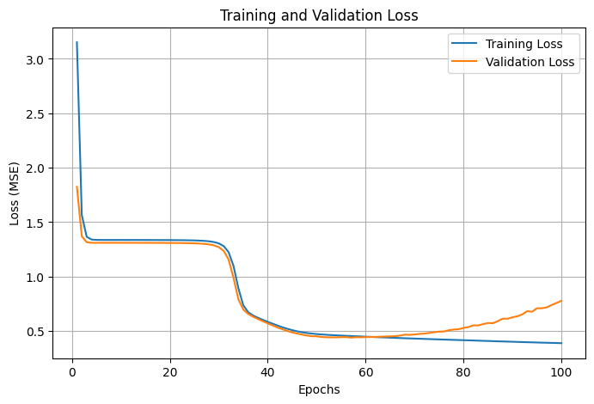
Regression
Using ANNs

Slide 6
Insights and Conclusion
Strengths: Reasonable MSE (0.7781) and MAE (0.6561), demonstrating effective learning.
Weaknesses: Moderate R² (0.4062) indicates room for improvement in capturing complex patterns.
Opportunities: Deeper networks and hyperparameter tuning could enhance performance.

Slide 7
PyTorch ANN (Classification)
Training
Configurations
Input: 784 (flattened 28x28 images)
Layers:
Hidden Layer 1: 128 units (ReLU)
Hidden Layer 2: 64 units (ReLU)
Output Layer: 10 units (Softmax)
Trainable Parameters: ~101,00
Learning Rate: 0.01
Batch Size: 32
Epochs: 20
Optimizer: SGD with weight decay (1e-4)

Slide 8
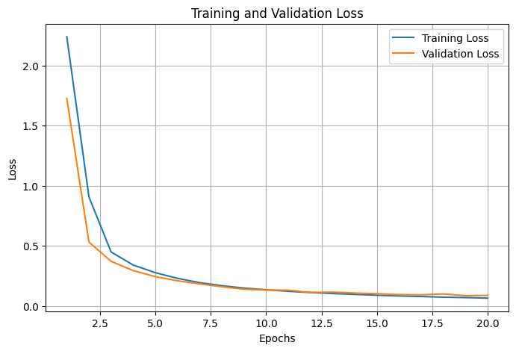
Classification
Using ANNs

Slide 9
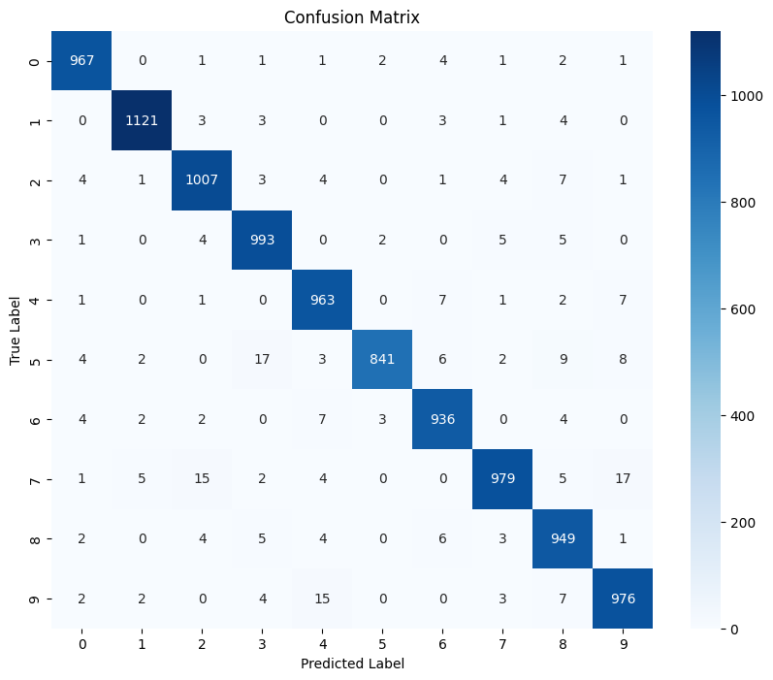
Classification
Using ANNs

Slide 10
Insights and Conclusion
Strengths: Excellent accuracy (97.32%) with balanced precision, recall, and F1 score.
Weaknesses: Limited scope for improvement; already highly optimized for MNIST.
Opportunities: Data augmentation and regularization could further generalize the model.

Slide 11
Keras CNN
(Classification)
Training
Configurations
Architectures:
Model 1: 2 convolutional layers, 2 pooling layers, 1 dense layer
Model 2: 3 convolutional layers, 3 pooling layers, 1 dense layer
Model 3: 1 convolutional layer, 1 pooling layer, 1 dense layer
Model 4: Similar to Model 2 but with larger kernel sizes
Learning Rate: 0.001
Batch: Size: 32
Epochs: 10
Optimizer: Adam

Slide 12
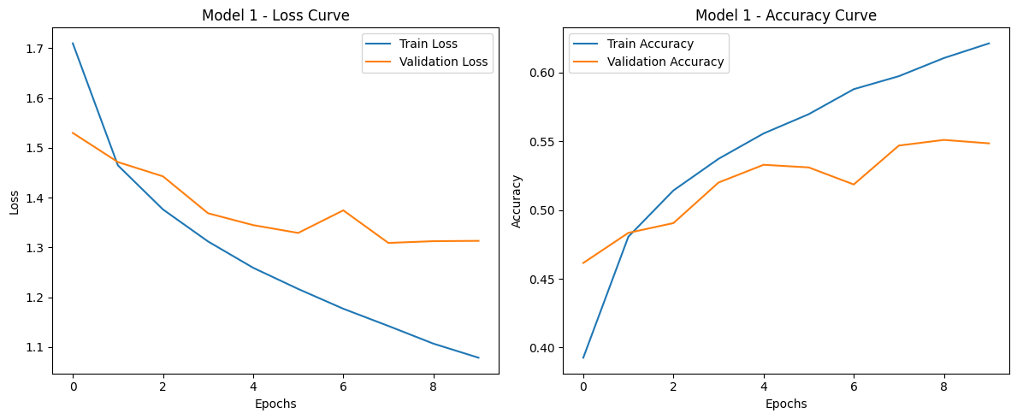
Classification
Using CNNs (Model 1)

Slide 13
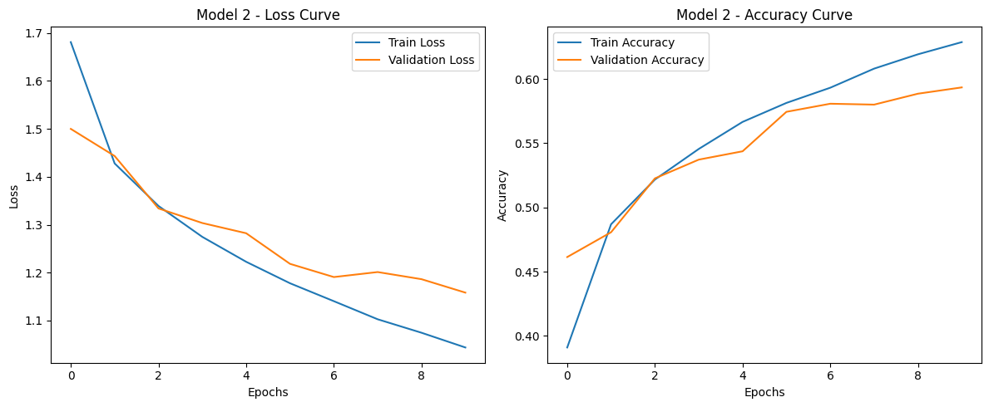
Classification
Using CNNs (Model 2)

Slide 14
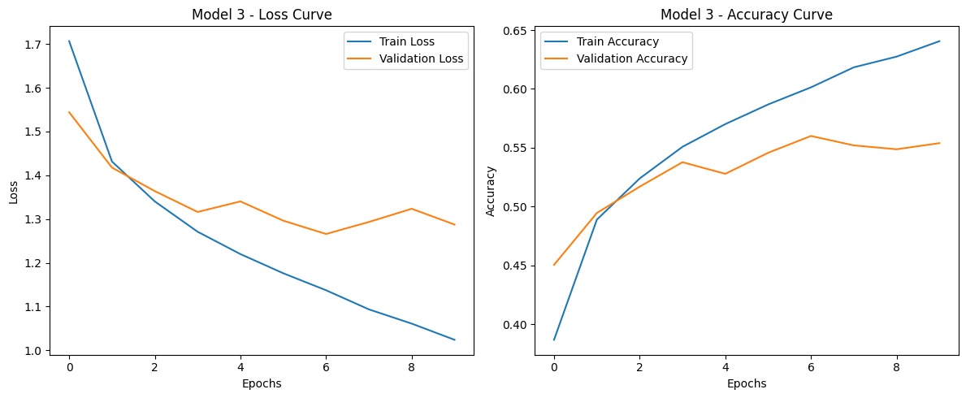
Classification
Using CNNs (Model 3)

Slide 15
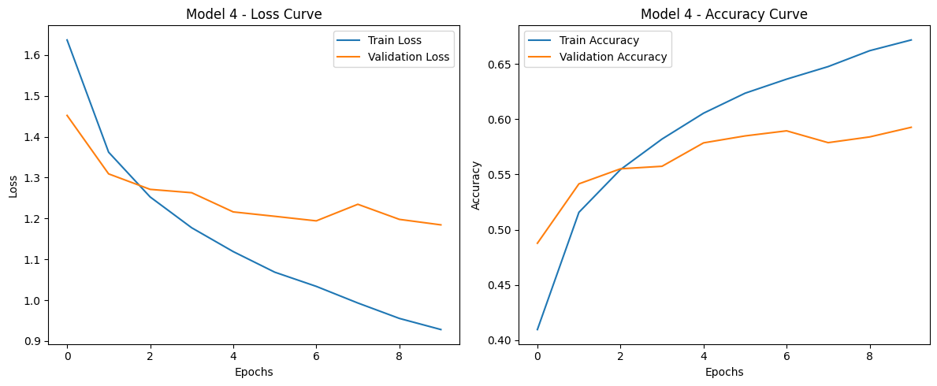
Classification
Using CNNs (Model 4)

Slide 16
Insights and Conclusion
Model 1: Baseline with 54.57% accuracy, limited by fewer layers.
Model 2: Improved accuracy (59.01%) with additional layers.
Model 3: Simple and efficient, but accuracy (55.55%) is lower.
Model 4: Best performance (59.55%) due to larger kernels and deeper architecture.

Slide 17
Thank you!

